Slide 1
Performance Management

Slide 2
Objectives
After completing this lesson, you should be able to:
  Use Enterprise Manager to monitor performance
  Use Automatic Memory Management (AMM)
  Use the Memory Advisor to size memory buffers
  View performance-related dynamic views
  Troubleshoot invalid and unusable objects
Notes:
Oracle Database 11g: Administration Workshop I 13 - <number>

Slide 3

Performance Monitoring
Memory
allocation
issues
Input/output
device
contention
Resource
contention
?
Application
code problems
DBA
Network
bottlenecks
Notes:
Oracle Database 11g: Administration Workshop I 13 - <number>
Performance Monitoring
To administer Oracle Database 11g and keep it running smoothly, the database administrator (DBA) must regularly monitor its performance to locate bottlenecks and correct problem areas.
A DBA can look at hundreds of performance measurements, covering everything from network performance and disk input/output (I/O) speed to the time spent working on individual application operations. These performance measurements are commonly referred to as database metrics.
Note: For more information about Oracle database performance, see the Oracle Database 11g: Performance Tuning course.

Slide 4
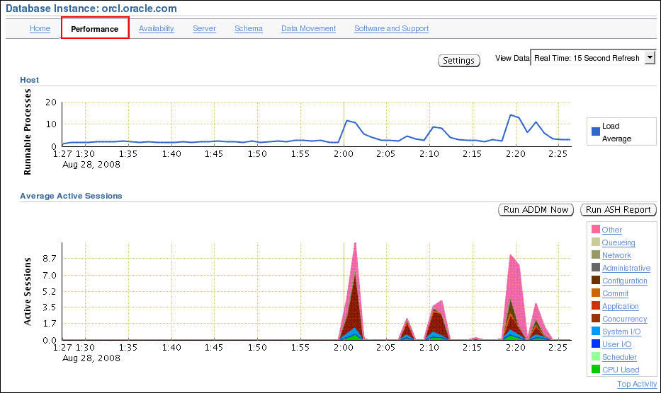
Enterprise Manager Performance Page
Notes:
Oracle Database 11g: Administration Workshop I 13 - <number>
Enterprise Manager Performance Page
The Performance page in Enterprise Manager is the portal to a powerful set of performance monitoring and tuning tools. The first set of graphs on this page summarizes processes and active session activity. The Average Active Sessions graph shows the level of CPU usage and the resources that are causing the most wait events.
In the slide, you see that there was a recent increase in Concurrency and Other waits. During each of these spikes there was also a slight increase in System I/O and CPU usage. You can click these categories to see more details about the waits. The I/O data is divided into types of I/O (for example, log file read, control file write, and so on).

Slide 5
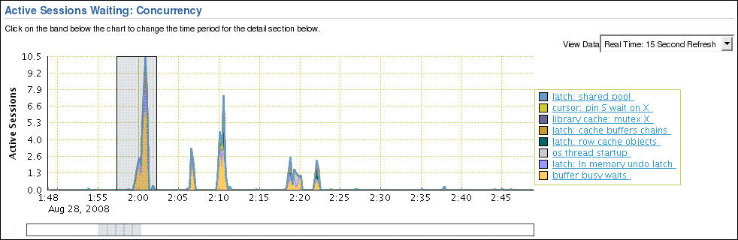
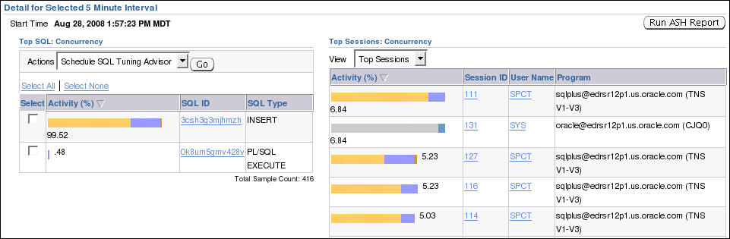
Drilling Down to a Particular Wait Category
Notes:
Oracle Database 11g: Administration Workshop I 13 - <number>
Drilling Down to a Particular Wait Category
When you drill down to a particular wait category, you can view details of specific five-minute intervals and also see the Top Working SQL and the Top Working Sessions associated with that particular wait event during that time. This enables you to perform after-the-fact analysis of system slowdowns and determine potential causes.
The example in the slide shows the results of drilling down on the Concurrency category from the Active Session graph in the previous slide.

Slide 6

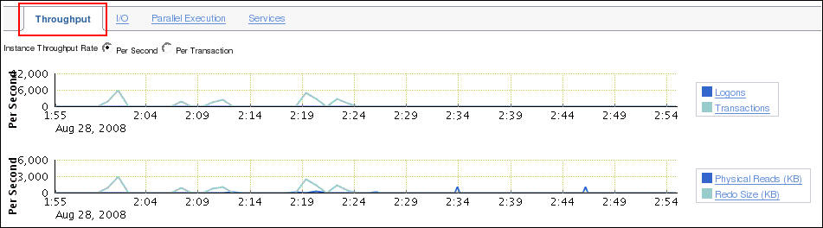
Performance Page: Throughput
Scroll down on the Performance page.
Notes:
Oracle Database 11g: Administration Workshop I 13 - <number>
Performance Page: Throughput
You can see graphs of Instance throughput and Instance Disk I/O by clicking the Throughput and I/O tabs on the main Performance page. The Throughput tab has been selected in the slide.

Slide 7
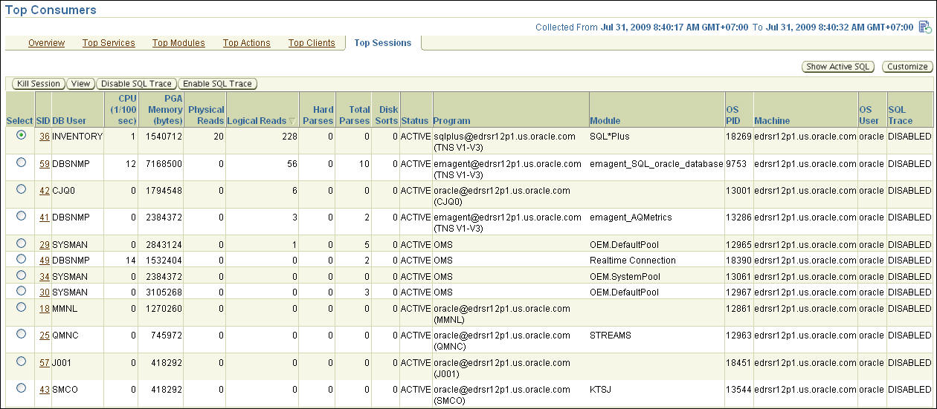
Performance Monitoring: Top Sessions
Notes:
Oracle Database 11g: Administration Workshop I 13 - <number>
Performance Monitoring: Top Sessions
Click Top Consumers in the Additional Monitoring Links section will take you to the Top Consumers page.
The Top Consumers Overview page shows in graphical format:
Top services
Top modules (by Service)
Top Actions (by Service and Module)
Top Clients
On the Top Consumers page, click the Top Sessions tab to see critical statistics of the sessions using the most resources
CPU
PGA Memory
Logical Reads
Physical Read
Hard Parse count,
Sort count.
Click a column name to have the results sorted by the value in that column.
The table on this page lists the sessions sorted by logical reads. This shows that the user INVENTORY in session 36 is producing the greatest number of logical reads at this particular time.

Slide 8
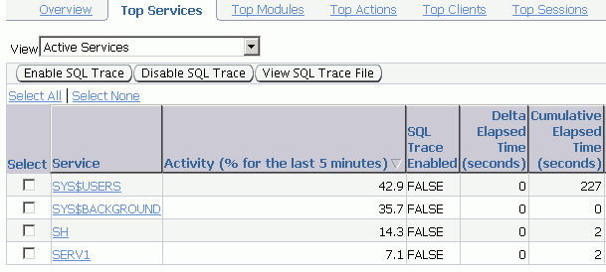
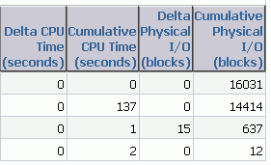
Performance Monitoring: Top Services
Notes:
Oracle Database 11g: Administration Workshop I 13 - <number>
Performance Monitoring: Top Services
In multitier systems where there is an application server that is pooling database connections, viewing sessions may not provide the information you need to analyze performance. Grouping sessions into service names enables you to monitor performance more accurately.
In the example in the slide, there are four services: SYS$USERS, SYS$BACKGROUND, SH, and SERV1. Regardless of the session that was used for a particular request, if it connected via one of these services, the performance data of the session is captured under that service name. Of the application services shown (SH and SERV1), it is clear from this listing that the SH service was more active during this five-minute interval.

Slide 9
Managing Memory
Components
  Automatic Memory Management (AMM)
    Enables you to specify total memory allocated to instance (including both SGA and PGA)
  Automatic Shared Memory Management (ASMM):
    Enables you to specify total SGA memory through one initialization parameter
    Enables the Oracle server to manage the amount of memory allocated to the shared pool, Java pool, buffer cache, streams pool, and large pool
  Manually setting shared memory management:
    Sizes the components through multiple individual initialization parameters
    Uses the appropriate Memory Advisor to make recommendations
Notes:
Oracle Database 11g: Administration Workshop I 13 - <number>
Managing Memory Components
Oracle Database 11g enables you to specify the total memory allocated to the instance. Memory will be dynamically reallocated between the System Global Area (SGA) and Program Global Area (PGA) as needed. This method is called Automatic Memory Management (AMM) and is available on only those platforms that support dynamic release of memory. This simplifies your memory management tasks.
Memory advisors are available to help you set the initialization parameters on various levels. Which advisor is available depends on the level on which you are specifying the memory parameters. If you enable AMM, only the Memory Size Advisor is available.
Automatic Shared Memory Management (ASMM) enables you to manage the SGA as a whole.
The SGA comprises several components. The sizes of many of these components are dynamically adjusted for best performance within the limits of the initialization parameters. When the AMM is enabled, the ASMM is automatically enabled. If the ASMM is enabled but not the AMM, the SGA Size Advisor is available.
You can manage the size of individual components manually by setting the initialization parameter for each component. If the Oracle server notifies you of a performance problem that is related to the size of an SGA or PGA component, you can use the Memory Advisor for the component to determine appropriate new settings. The Memory Advisor can model the effect of parameter changes.

Slide 10

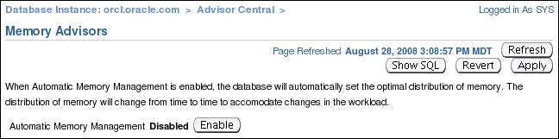
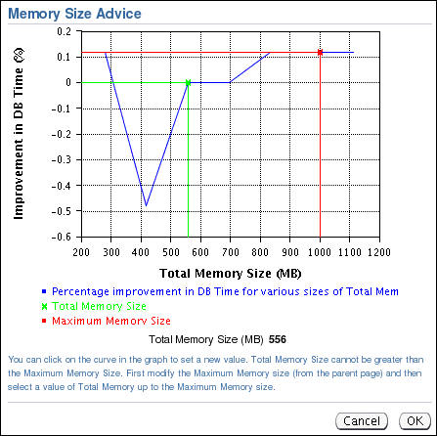
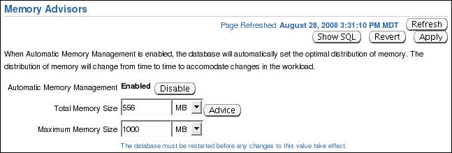
Enabling Automatic Memory Management (AMM)
Click Enable to enable Automatic Memory Management.
Use the Memory Size Advisor.
Notes:
Oracle Database 11g: Administration Workshop I 13 - <number>
Enabling Automatic Memory Management (AMM)
If you did not enable Automatic Memory Management (AMM) when you configured your database, you can enable it by performing the following steps:
1. On the Database home page, click the Server tab.
2. Click Memory Advisors in the Database Configuration region.
The Memory Advisors page appears.
3. Click Enable for Automatic Memory Management.
The Enable Automatic Memory Management page appears.
4. Set the values for Total Memory Size and Maximum Memory Size for Automatic Memory Management.
Note: If you change the Maximum Memory Size, the database instance must be restarted.
5. Click OK.
You can increase the size at a later time by increasing the value of the Total Memory Size field or the MEMORY_TARGET initialization parameter. However, you cannot set it higher than the value specified by the Maximum Memory Size field or the MEMORY_MAX_TARGET parameter. For more information, see the Oracle Database Administrator’s Guide.
After AMM is enabled, the Memory Size Advisor is available to help you adjust the maximum and target memory sizes.
Note: Oracle recommends that you use Automatic Memory Management to simplify memory management tasks.

Slide 11
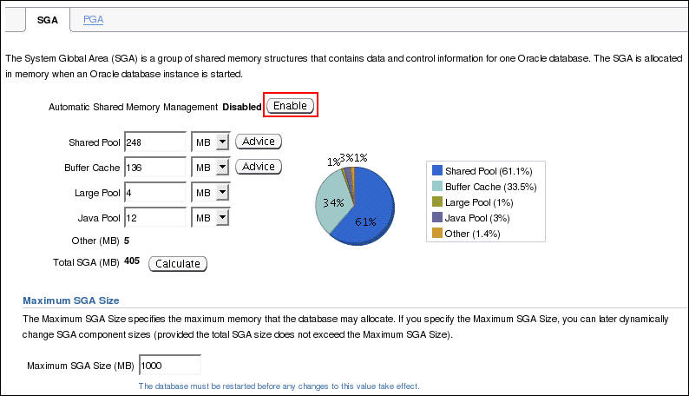
Enabling Automatic Shared
Memory Management (ASMM)
Click Enable to enable Automatic Shared Memory Management.
Notes:
Oracle Database 11g: Administration Workshop I 13 - <number>
Enabling Automatic Shared Memory Management (ASMM)
Automatic Shared Memory Management is automatically enabled if you have enabled AMM. If you have not enabled AMM or did not enable ASMM when you configured your database, you can enable Automatic Shared Memory Management by performing the following steps:
1. On the Database home page, click the Server tab.
2. Click Memory Advisors in the Database Configuration region.
The Memory Advisors page appears.
3. Scroll down to the SGA section. Click Enable for Automatic Shared Memory Management.
The Enable Automatic Shared Memory Management page appears.
4. Specify the total SGA size. Click OK.
You can increase the total SGA size at a later time by increasing the value of the Total SGA Size field or the SGA_TARGET initialization parameter. However, you cannot set it higher than the value specified by the Maximum SGA Size field or the SGA_MAX_SIZE parameter. For more information, see the Oracle Database Administrator’s Guide.
When AMM is disabled, the PGA advisor is accessible. The PGA advisor is recommended for setting the PGA memory value. Click the PGA tab to access the PGA property page. Click Advice to invoke the PGA Advisor.
Note: Oracle recommends that you use Automatic Shared Memory Management to simplify your memory management tasks.

Slide 12
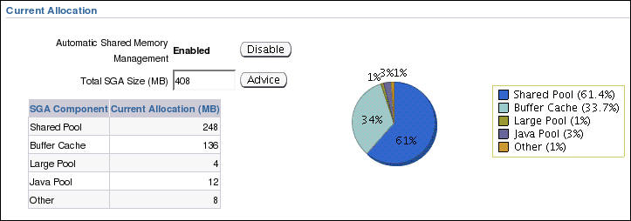
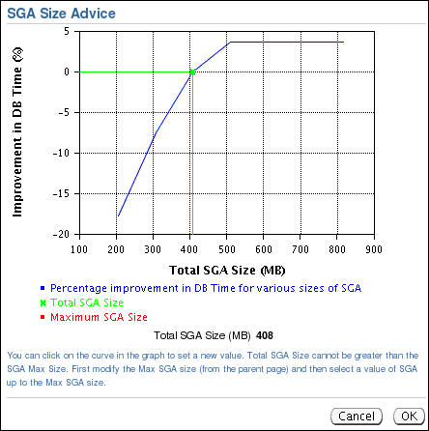
Automatic Shared Memory
Advisor
Notes:
Automatic Shared Memory Advisor
When ASMM is enabled, you should not set the initialization parameters for the specific components of shared memory that ASMM manages. After ASMM is enabled, the SGA Size Advisor is available to help you choose the best value for total SGA size.
Before enabling ASMM, you should remove the individual memory area parameters from the SPFILE because having them set can impose restrictions on ASMM. If, after seeing the effects of the ASMM allocations, you decide that you want to adjust certain component allocations, you can specify values for those components. If the values you are specifying are lower than the current values, then those values are treated as minimum memory sizes for their respective components. If the values you are specifying are larger than the current values, then the size of the memory components are resized upward to the values you provided as long as free memory is available. Doing this limits the amount of memory available for automatic adjustment, but the capability is available if your environment requires special sizing that is not accommodated by ASMM.
The initialization parameters of concern are the following:
SHARED_POOL_SIZE
LARGE_POOL_SIZE
JAVA_POOL_SIZE
DB_CACHE_SIZE
STREAMS_POOL_SIZE
To adjust these parameters while ASMM is enabled, you must use the ALTER SYSTEM command.

Slide 13
Dynamic Performance Statistics
Systemwide
Session specific
Service specific
V$SYSSTAT
statistic#
name
class
value
stat_id
V$SESSTAT
sid
statistic#
value
V$SERVICE_STATS
service_name_hash
service_name
stat_id
stat_name
value
V$SYSTEM_EVENT
event
total_waits
total_timeouts
time_waited
average_wait
time_waited_micro
V$SESSION_EVENT
sid
event
total_waits
total_timeouts
time_waited
average_wait
max_wait
time_waited_micro
event_id
V$SERVICE_EVENT
service_name
service_name_hash
event
event_id
total_waits
total_timeouts
time_waited
average_wait
time_waited_micro
Cumulative stats
Wait events
Notes:
Dynamic Performance Statistics
Statistics must be available for the effective diagnosis of performance problems. The Oracle server generates many types of statistics for different levels of granularity.
At the systemwide level, session level, and service level, both wait events and accumulated statistics are computed. In the slide, the top row of views shows the cumulative statistics. The bottom row shows the wait event views.
When analyzing a performance problem in any of these scopes, you typically look at the change in statistics (delta value) over the period of time you are interested in. All the possible wait events are cataloged in the V$EVENT_NAME view. All statistics are cataloged in the V$STATNAME view; approximately 480 statistics are available in Oracle Database.

Slide 14
Notes:
Dynamic Performance Statistics (continued)
Displaying Systemwide Statistics
Example:
SQL> SELECT name, class, value FROM v$sysstat;
NAME CLASS VALUE
------------------------------- ------ ----------
...
table scans (short tables) 64 135116
table scans (long tables) 64 250
table scans (rowid ranges) 64 0
table scans (cache partitions) 64 3
table scans (direct read) 64 0
table scan rows gotten 64 14789836
table scan blocks gotten 64 558542
...
Systemwide statistics are classified by the tuning topic and the debugging purpose. The classes include general instance activity, redo log buffer activity, locking, database buffer cache activity, and so on.

Slide 15
Troubleshooting and Tuning Views
Instance/Database
V$DATABASE
V$INSTANCE
V$PARAMETER
V$SPPARAMETER
V$SYSTEM_PARAMETER
V$PROCESS
V$BGPROCESS
V$PX_PROCESS_SYSSTAT
V$SYSTEM_EVENT
Disk
V$DATAFILE
V$FILESTAT
V$LOG
V$LOG_HISTORY
V$DBFILE
V$TEMPFILE
V$TEMPSEG_USAGE
V$SEGMENT_STATISTICS
Contention
V$LOCK
V$UNDOSTAT
V$WAITSTAT
V$LATCH
Memory
V$BUFFER_POOL_STATISTICS
V$LIBRARYCACHE
V$SGAINFO
V$PGASTAT
Notes:
Troubleshooting and Tuning Views
The slide lists some of the views that can help you determine the cause of performance problems or analyze the current status of your database.
For a complete description of these views, see the Oracle Database Reference.

Slide 16





Invalid and Unusable Objects
Effect on performance:
  PL/SQL code objects are recompiled.
  Indexes are rebuilt.
Notes:
Oracle Database 11g: Administration Workshop I 13 - <number>
Invalid and Unusable Objects
Invalid PL/SQL objects and unusable indexes have an impact on performance. Invalid PL/SQL object must be recompiled before they can be used. This requires the compile time to be added to the first action that attempts to access the PL/SQL package, procedure, or function. If the PL/SQL does not recompile successfully, the operation fails with an error. Unusable indexes are ignored by the optimizer. If proper performance of a SQL statement depends on an index that has been marked unusable, the performance does not improve until the index is rebuilt.
Invalid PL/SQL objects: The current status of PL/SQL objects can be viewed by querying the data dictionary. You can find invalid PL/SQL objects with:
SELECT object_name, object_type FROM DBA_OBJECTS
WHERE status = 'INVALID';
By default, the Owner’s Invalid Object Count metric is checked every 24 hours. If the number of objects for an individual owner exceeds two, an alert is issued.
If you find PL/SQL objects with a status of INVALID, the first question that you need to answer is “Has this object ever been VALID?” An application developer often neglects to clean up code that does not work. If the PL/SQL object is invalid because of a code error, there is little that can be done until that error is fixed. If the procedure was valid at some time in the past and has recently become invalid, you have two options for fixing the problem:

Slide 17
Notes:
Invalid and Unusable Objects (continued)
Do nothing. Most PL/SQL objects automatically recompile if needed when they are called. Users experience a slight delay while the objects recompile. (In most cases, this delay is not even noticeable.)
Manually recompile the invalid object.
Invalid PL/SQL objects can be manually recompiled by using Enterprise Manager or through SQL commands:
ALTER PROCEDURE HR.add_job_history COMPILE;
Manually recompiling PL/SQL packages requires two steps:
ALTER PACKAGE HR.maintainemp COMPILE;
ALTER PACKAGE HR.maintainemp COMPILE BODY;
Unusable indexes: Invalid indexes can be found by querying the DBA_INDEXES data dictionary view:
SELECT index_name, table_name FROM DBA_INDEXES
WHERE status = 'UNUSABLE';
For partitioned indexes, the status is held in the DBA_IND_PARTITIONS view.
Unusable indexes are made valid by rebuilding them to recalculate the pointers. Rebuilding an unusable index re-creates the index in a new location and then drops the unusable index. This can be done either by using Enterprise Manager or through SQL commands:
ALTER INDEX HR.emp_empid_pk REBUILD;
ALTER INDEX HR.emp_empid_pk REBUILD ONLINE;
ALTER INDEX HR.email REBUILD TABLESPACE USERS;
If the TABLESPACE clause is left out, the index is rebuilt in the same tablespace where it already exists. The REBUILD ONLINE clause enables users to continue updating the index’s table while the rebuild takes place. (Without the ONLINE keyword, users must wait for the rebuild to finish before performing DML on the affected table. If the index is unusable, it is not used during the rebuild even if the ONLINE keyword is used.)
Enterprise Manager uses the Reorganize action to repair an UNUSABLE index.
Note: Rebuilding an index requires that free space be available for the rebuild. Verify that there is sufficient space before attempting the rebuild. Enterprise Manager automatically checks space requirements.

Slide 18
Quiz
Automatic Memory Management allows the Oracle instance to reallocate memory from the _______ to the SGA .
  Large Pool
  Log Buffer
  PGA
  Streams Pool
Notes:
Answer: 3

Slide 19
Quiz
SGA_TARGET may not be sized greater than __________ .
  LOG_BUFFER
  SGA_MAX_SIZE
  STREAMS_POOL_SIZE
  PGA_AGGREGATE_TARGET
Notes:
Answer: 2

Slide 20
Summary
In this lesson, you should have learned how to:
  Use Enterprise Manager to monitor performance
  Use Automatic Memory Management (AMM)
  Use the Memory Advisor to size memory buffers
  View performance-related dynamic views
  Troubleshoot invalid and unusable objects
Notes:
Oracle Database 11g: Administration Workshop I 13 - <number>

Slide 21
Practice 13 Overview:
Monitoring and Improving Performance
This practice covers the following topics:
  Detecting and repairing unusable indexes
  Using the Performance page in Enterprise Manager
Notes:
Oracle Database 11g: Administration Workshop I 13 - <number>

